Slide 1
Java Applet
What is a Java Applet?
  Another Java Application (without main method)
How is applet compiled?
  Just like normal java class.
How can we execute an applet?
  Using applet viewer , that is, appletviewer
  Using a Java compatible web browser.

Slide 2
Life Cycle
  init Method (like constructor) - for one-time initialization, typically contains the code that you would normally put into a constructor.
  start Method - starts the execution of the applet.
  paint method (Output ): painting and repainting of the applet
  stop Method- suspends the applet's execution, so that it doesn't take up system resources when the user isn't viewing the applet's page. For example, an applet that displays an animation should stop trying to draw the animation when the user isn't viewing it.
  destroy Method - the destroy method is available for applets that need to release additional resources.
  All these methods are inherited from Applet class

Slide 3
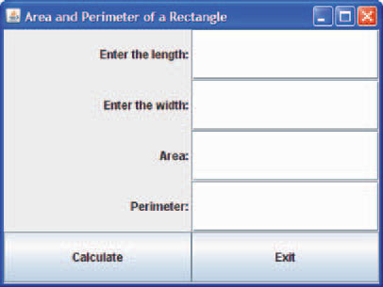
Java GUI
Design GUI based java program to find the area and perimeter of a rectangle given its length and width.

Slide 4
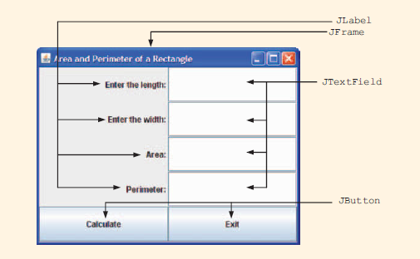
All are available in the package : javax.swing

Slide 5
Step 1 : Creating the Container window
Step 2 : Adding content pane to The Container Window
  Step 3: Setting layout inside content pane
  The class Container in java.awt provides the method set Layout, to set the layout of the content pane.
  pane.setLayout(new GridLayout(5, 2));
  The above statement calls the constructor of the class Grid Layout and sets the number of rows to 5 and the number of columns to 2
Step 4: Adding Components to the content pane

Slide 6
Step 5 : Adding soul to Components
Event Handling Mechnism :
Event An object that describes a state change in a source.
  Examples:
    Action Event , FocusEvent,KeyEvent e.t.c
    Listener : An object that is notified when an event occurs Examples :
    ActionListener, FocusListener, KeyListener e.t.c

Slide 7
Implementation of Event Handling Mechanism :
  Implement the abstract method given in the Listener Interface with the help of class .
  Now use add Listener method to attach the listener to the
  Command button with the help of class that implements listener.

Slide 8
ActionListener Interface :
  public interface ActionListener{
    public void actionPerformed(ActionEvent e);}
Implementing the abstract method given in the ActionListener interface for Calculate Button
  private class CalculateButtonHandler implements ActionListener {
  public void actionPerformed(ActionEvent e) {
  double width, length, area, perimeter;
  length = Double.parseDouble(lengthTF.getText());
  width= Double.parseDouble(widthTF.getText());
  area = length * width;
  perimeter = 2 * (length + width);
  areaTF.setText("" + area);
  perimeterTF.setText("" + perimeter);
  }}
  Implementing the abstract method given in the ActionListener interface for Exit Button
  private class ExitButtonHandler implements ActionListener {
  public void actionPerformed(ActionEvent e) {
System.exit(0)
  }}

Slide 9
  Using add Listener method
  //Create Calculate Button
  calculate B = new JButton("Calculate");
  cbHandler = new CalculateButtonHandler();
  calculateB.addActionListener(cbHandler);
  //Create Exit Button
  exitB = new JButton("Exit");
  ebHandler = new ExitButtonHandler();
  exitB.addActionListener(ebHandler);

Slide 10
Final Code
import javax.swing.*;
import java.awt.*;
import java.awt.event.*;
public class RectangleGUIFinal extends JFrame {
private JLabel lengthL, widthL, areaL, perimeterL;
private JTextField lengthTF, widthTF, areaTF, perimeterTF;
private JButton calculateB, exitB;
private CalculateButtonHandler cbHandler;
private ExitButtonHandler ebHandler;
private static final int WIDTH = 400;
private static final int HEIGHT = 300;
public RectangleGUIFinal () {
//Create the four labels
lengthL = new JLabel("Enter the length: ", SwingConstants.RIGHT);
widthL = new JLabel("Enter the width: ", SwingConstants.RIGHT);
areaL = new JLabel("Area: ", SwingConstants.RIGHT);
perimeterL = new JLabel("Perimeter: ", SwingConstants.RIGHT);

Slide 11
//Create the four text fields
lengthTF = new JTextField(10);
widthTF = new JTextField(10);
areaTF = new JTextField(10);
perimeterTF = new JTextField(10);
//Create Calculate Button
calculateB = new JButton("Calculate");
cbHandler = new CalculateButtonHandler();
calculateB.addActionListener(cbHandler);
//Create Exit Button
exitB = new JButton("Exit");
ebHandler = new ExitButtonHandler();
exitB.addActionListener(ebHandler);

Slide 12
//Step 1 : Creating the Container window
setTitle("Area and Perimeter of a Rectangle");
setSize(WIDTH, HEIGHT);
setVisible(true);
setDefaultCloseOperation(EXIT_ON_CLOSE);
// Step 2 : Adding content pane to The Container Window
Container pane = getContentPane();
//Step 3: Setting layout inside content pane
pane.setLayout(new GridLayout(5, 2));
//Step 4: Adding Components to the content pane
pane.add(lengthL);
pane.add(lengthTF);
pane.add(widthL);
pane.add(widthTF);
pane.add(areaL);
pane.add(areaTF);
pane.add(perimeterL);
pane.add(perimeterTF);
pane.add(calculateB);
pane.add(exitB);
}

Slide 13
//Step 5 : Adding soul to Components
private class CalculateButtonHandler implements ActionListener{
public void actionPerformed(ActionEvent e){
double width, length, area, perimeter;
length = Double.parseDouble(lengthTF.getText());
width = Double.parseDouble(widthTF.getText());
area = length * width;
perimeter = 2 * (length + width);
areaTF.setText("" + area);
perimeterTF.setText("" + perimeter);
}
}
private class ExitButtonHandler implements ActionListener{
public void actionPerformed(ActionEvent e){
System.exit(0);
}
}
public static void main(String[] args){
RectangleGUIFinal rectObject = new RectangleGUIFinal ();
}
}

Slide 14
Converting Java Application to Applet
Five steps to convert a GUI application to an applet:
  Make your class extend the definition of the class JApplet. In other words, change JFrame to JApplet.
  Change the constructor to the method init.
  Remove the method main and add method paint
  Remove Step 1 : Creating the Container window.
  Remove the Exit command button and all the things related to it i.e listener e.t.c.

Slide 15
Final Code
import javax.swing.*;
import java.awt.*;
import java.awt.event.*;
import java.awt.Graphics; // program uses class Graphics
import javax.swing.JApplet; // program uses class JApplet
public class RectangleGUIFinal extends JApplet{
private JLabel lengthL, widthL, areaL, perimeterL;
private JTextField lengthTF, widthTF, areaTF,perimeterTF;
private JButton calculateB, exitB;
private ExitButtonHandler ebHandler;
private CalculateButtonHandler cbHandler;
public void init () {
//Create the four labels
lengthL = new JLabel("Enter the length: ", SwingConstants.RIGHT);
widthL = new JLabel("Enter the width: ", SwingConstants.RIGHT);
areaL = new JLabel("Area: ", SwingConstants.RIGHT);
perimeterL = new JLabel("Perimeter: ", SwingConstants.RIGHT);

Slide 16
//Create the four text fields
lengthTF = new JTextField(10);
widthTF = new JTextField(10);
areaTF = new JTextField(10);
perimeterTF = new JTextField(10);
//Create Calculate Button
calculateB = new JButton("Calculate");
cbHandler = new CalculateButtonHandler();
calculateB.addActionListener(cbHandler);
//Create Exit Button
exitB = new JButton("Exit");
ebHandler = new ExitButtonHandler();
exitB.addActionListener(ebHandler);

Slide 17
// Step 2 : Adding content pane to The Container Window
Container pane = getContentPane();
//Step 3: Setting layout inside content pane
pane.setLayout(new GridLayout(5, 2));
//Step 4: Adding Components to the content pane
pane.add(lengthL);
pane.add(lengthTF);
pane.add(widthL);
pane.add(widthTF);
pane.add(areaL);
pane.add(areaTF);
pane.add(perimeterL);
pane.add(perimeterTF);
pane.add(calculateB);
pane.add(exitB);
}

Slide 18
//Step 5 : Adding soul to Components
private class CalculateButtonHandler implements ActionListener{
public void actionPerformed(ActionEvent e){
double width, length, area, perimeter;
length = Double.parseDouble(lengthTF.getText());
width = Double.parseDouble(widthTF.getText());
area = length * width;
perimeter = 2 * (length + width);
areaTF.setText("" + area);
perimeterTF.setText("" + perimeter);
}
}
private class ExitButtonHandler implements ActionListener{
public void actionPerformed(ActionEvent e){
System.exit(0);
}
}
public void paint( Graphics g ){
super.paint( g );
}
}

