Slide 1
Process & Multiprocessing
Process ?
  Simply can be defined as a program in execution having its own memory space
  No two processes share their address space or memory space.
  Process is heavy weighted
Multiprocessing?
  Allowing more than one processes to be running at one time.
  CPU switches back-and-forth among these processes using scheduling scheme, providing an illusion of running more than one programs at the same time.
  Context switching is a heavy weight job

Slide 2
Thread & Multithreading
Thread ?
  A point of execution in a process.
  All threads share the same memory space of the parent process
  Thread is considered as “light weight process”.
Multithreading?
  Allowing more than one threads to be running at one time.
  Switching back-and-forth among these threads is done by using scheduling scheme of JVM or OS.
  Context switching is light weight job.

Slide 3
Benefits of Multithreading
Utilization of multiprocessor architectures.
Responsiveness. Multithreading an interactive application may allow a program to continue running even if part of it is blocked or is performing a lengthy operation.
Resource sharing. By default, threads share the memory and the resources of the process to which they belong. The benefit of sharing code and data is that it allows an application to have several different threads of activity within the same address space.

Slide 4
Creating Thread
Two ways to create thread:
1) Extend Thread class (Thread class is present in package java.lang.*)
2) Implement Runnable interface
The thread class has number of methods which can be overridden but most important method is run() that contains the statements to be executed by the thread so run() is to be implemented. After creating the object of the class which extends thread class we start the thread using start() method . The start() method implicitly call the run() method itself.
The interface has only one method run() that contains the statements to be executed by the thread so run() is to be implemented. After creating the object of the class which implements interface the object is passed to the Thread constructor (this is not there if we are extending thread class) then we start the thread using start() method . The start() method implicitly call the run() method itself.

Slide 5
class demo extends Thread
{
public void run()
{
for (int i=0;i<15;i++)
{
System.out.println(getName()+"\ti=\t"+i);
}
}
demo()
{
start(); //we can write d1.start() ,d2.start() in its place
}
public static void main(String args[])
{
demo d1=new demo();
d1.setName("thread1");
//d1.start();
demo d2=new demo();
d2.setName("thread2");
//d2.start();
}}

Slide 6
public class demo implements Runnable
{
public void run()
{
for (int i=0;i<5;i++)
{
Thread t=Thread.currentThread();//while we extends thread class it is not required
System.out.println(t.getName()+"\ti=\t"+i);
}}
public static void main(String args[])
{
demo d1=new demo();
Thread thread1 = new Thread(d1);
thread1.setName("thread1");
thread1.start();
demo d2=new demo();
Thread thread2 = new Thread(d2);
thread2.setName("thread2");
thread2.start();
}}

Slide 7
Extending Using Thread class | Implementing Interface
Directly use start() with object of class | The object of class is passed to the Thread class constructor then use start() with object of Thread class
Threads Can Be Started By Giving Start() In Constructor or By Using Objectname . Start() | Threads Cannot Be Started By Giving Start() In Constructor We have to use Objectname .Start()
Not preferable | Instead of above it is Preferable

Slide 8
Why Implementing Interface in suggested
A better way to create a thread in Java is to implement Runnable interface. A thread can be created by extending Java Thread class also. Now the question arises why implementing Runnable interface is a better approach? Answer is, if the thread class you are creating is to be subclass of some other class, it can’t extend from the Thread class. This is because Java does not allow multiple inheritance . In such a case one can use Runnable interface to implement threads.

Slide 9
Exercise
Use the Thread class to convert the following class into a thread.
public class Demo2
{
void call_function(){
for (int i=0;i<5;i++)
{
System.out.println(i);}}
public static void main(String args[])
{
Demo2 d1=new Demo2();
Demo2 d2=new Demo2();
d1.call_function();
d2.call_function();
}}

Slide 10
Solution
public class Demo2 extends Thread
{
public void run()
{
call_function();
}
void call_function(){
for (int i=0;i<5;i++)
{
System.out.println(i);
}}
public static void main(String args[])
{
Demo2 d1=new Demo2();
Demo2 d2=new Demo2();
d1.start();
d2.start();
}}

Slide 11
Exercise
Use the Runnable interface to convert the following class into a thread.
public class Demo2
{
void call_function(){
for (int i=0;i<5;i++)
{
System.out.println(i);}}
public static void main(String args[])
{
Demo2 d1=new Demo2();
Demo2 d2=new Demo2();
d1.call_function();
d2.call_function();
}}

Slide 12
Solution
public class Demo2 implements Runnable
{
public void run()
{
call_function();
}
void call_function(){
for (int i=0;i<5;i++)
{
System.out.println(i);
}}
public static void main(String args[])
{
Demo2 d1=new Demo2();
Thread thread1 = new Thread(d1);
Demo2 d2=new Demo2();
Thread thread2 = new Thread(d2);
thread1.start();
thread2.start();
}}

Slide 13
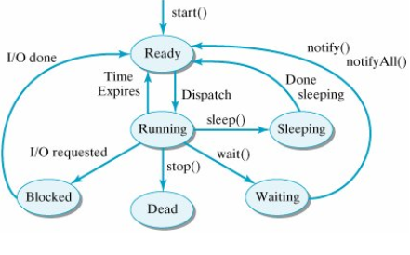
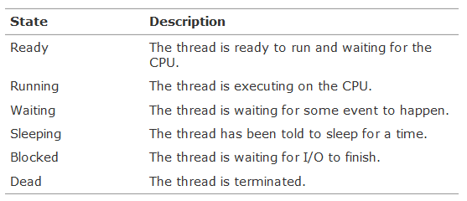
Thread States & Life Cycle

Slide 14
When first created, a thread is in the ready state, which means that it is ready to run. In the ready state, a thread is waiting in the ready queue.
Transitions represented by method name ssuch as start(), stop(), wait(), notify(), sleep() can be controlled by the program.
void suspend() & void resume()
When no thread is suspended both threads are under execution. When First thread goes into suspended state , only Second thread is executing. Now resume First thread . Similarly, when the Second goes to suspended state, only the First is executing.
Once a thread is suspended it can be resumed later on but once a thread is stopped ,it is dead.
Suspend() sometimes cause serious system failures . Assume a thread is suspended when it is executing the monitor code. So it will never relinquish the lock. This may cause the other thread waiting deadlocked.

Slide 15
Wait() | Sleep()
Wait() should be called from synchronized block | There is no such restriction on Sleep()
Wait() release the lock | Sleep() keeps the lock with it if it is called from synchronized block

Slide 16
Synchronization
Threads are asynchronous. This means that the order of execution is unpredictable
In java synchronization is done by using 2 techniques:
Synchronized method
Synchronized statement
Synchronized method:-
If you declare any method as synchronized, it is known as synchronized method . When a thread invokes a synchronized method, it automatically acquires the lock for that object and releases it when the thread completes its task.
Synchronized statement:-
Synchronized statement is a block in which we place the object and the method which are needed to be synchronized , Synchronized statement is placed in the run() within the thread class . Synchronizing method is the best way to restrict the use of method one at a time . However it is not always possible to synchronize the method such as when encountering a class which is provided by third party(as they don’t give yu the code).So we have to use Synchronized statement.
public void run(){
synchronized(obj)
{ obj.table(5); }}

