Slide 1
Hidden Surface Removal / Visible Surface Detection
Hidden Surface Removal / Visible Surface Detection means detection of Visible surfaces on projection of 3D object to 2D screen
Painter Algorithm or Depth Sorting or Priority Fill
Z Buffer Algorithm
A Buffer Algorithm
Scan Line Method ( line coherence)
Area Subdivision Algorithms ( Warnock's Algorithm ) (area coherence)

Slide 2
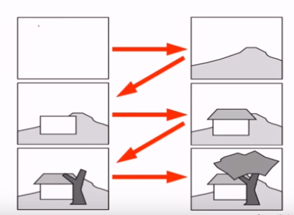
Painter Algorithm (Depth Sorting)
  Idea: Painter Creates the picture by drawing background scene elements before foreground ones

Slide 3
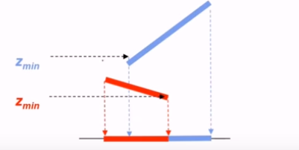
  Algorithm :
  Compute Z min for each polygon
  Project Polygons with furthest Z min first

Slide 4
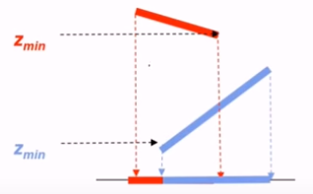

Slide 5
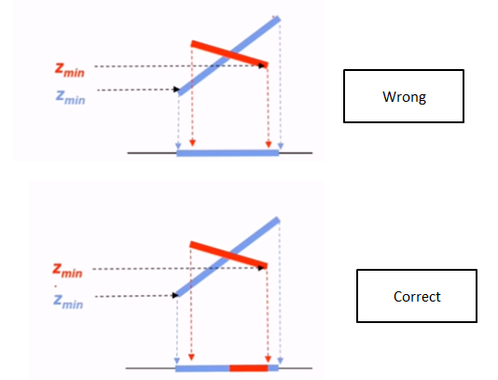
Therefore painters algorithm fails. Next we will study Z Buffer algorithm

Slide 6
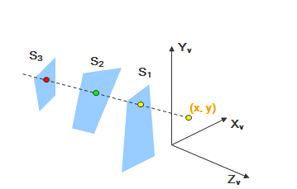
Z Buffer Algorithm/ Depth Buffer Algorithm

Slide 7
The two buffers are used for the purpose :
Z buffer or Depth Buffer : which stores the Z value of the corresponding pixel
Frame Buffer : which stores the color value ( intensity value ) for the corresponding pixel
The size of these two Buffers is same as the screen size .

Slide 8
Initialise the depth buffer and frame buffer so that for all buffer positions (x, y)
depth Buff(x, y) = infinity
frame Buff(x, y) = bgColour
2. Process each polygon in a scene, one at a time
i) For each projected (x, y) pixel position of a polygon, calculate the depth z
ii) If z < depth Buff(x, y), compute the surface color at that position and set
depth Buff(x, y) = z
frame Buff(x, y) = surfColour(x, y)

Slide 9
We know the equation of Plane is
At any surface position the depth is calculated from the plane equation as:
Depth values along the edge being considered are calculated using ( Proof discussed in class)

Slide 10
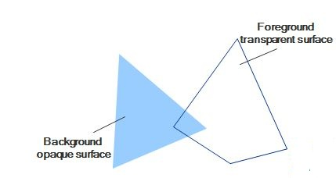
This method only finds one visible surface at each pixel position that means it deals with only opaque surfaces

Slide 11

A-buffer algorithm
The A-buffer expands on the depth buffer method to allow transparencies
Each position in the A-buffer has two fields Depth field: Stores a positive or negative real number Intensity field: Stores surface-intensity information or a pointer value
If the depth field is positive
  The number at that position is the depth
  The intensity field stores the RGB
If the depth field is negative
  Multiple-surface contributions to the pixel
  The intensity field stores a pointer to a linked list of surfaces

Slide 12
  Data for each surface in in the linked list
RGB intensity components
Opacity parameters(percent of transparency)
Depth
Pointers to next surface

Slide 13
Scan-Line Method
Analysis is done scan line by scan line rather than polygon by polygon.
Depth calculations need to be done for each overlapping surface. The intensity of the nearest position is entered into the frame buffer. To handle so for each scan line we need to maintain two things
Active Edge list
  Contain only edges across the current scan line
  Sorted in order of increasing x
Flag for each surface
  At the leftmost boundary of a surface The surface flag is turned on
  At the rightmost boundary of a surface The surface flag is turned off

Slide 14
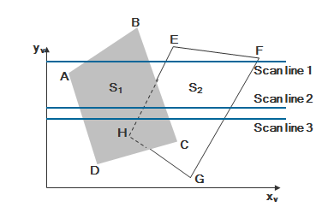
For scan line 1 Active Edge list: AB, BC, EH, and FG Between AB and BC, only the flag for surface S1 is on therefore No depth calculations are necessary. Intensity for surface S1 is entered into the frame buffer Similarly, between EH and FG, only the flag for S2 is on therefore No depth calculations are necessary. Intensity for surface S2 is entered into the frame buffer

Slide 15
For scan line 2 Active Edge list: AD, EH, BC, and FG Between AD and EH, only the flag for S1 is on therefore No depth calculations are necessary. Intensity for surface S1 is entered into the frame buffer Between EH and BC, the flags for both surfaces are on Depth calculation is needed. Depth of S1 is less therefore Intensities for S1 are loaded into the refresh buffer until BC Between BC and FG , only the flag for S2 is on therefore No depth calculations are necessary. Intensity for surface S2 is entered into the frame buffer

Slide 16
For scan line 3 Active Edge list: AD, EH, BC, and FG Active Edge list of scan line 2 and scan line 3 is same therefore take advantage of coherence Coherence Making use of the results calculated for one part of the scene or image for other nearby parts. Coherence is the result of local similarity

Slide 17
Area Subdivision Algorithms ( Warnock's Algorithm )
Use "divide and conquer" and "area coherence"
Recursively subdivide the projection plane image until a decision can be made

Slide 18
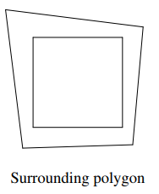
First of all we will start will AOI such that it contains all the polygons of the image then we will subdivide the area into 4 equal parts and continue the subdivision until Area belong to one of the following :
Surrounding : Fill the area with the intensity value of the surrounding polygon

Slide 19
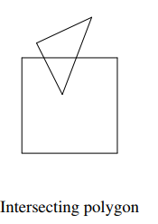
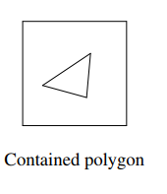
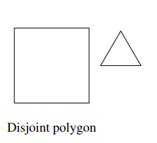
2. Intersecting Or Contained : Fill the area with background intensity value and then scan convert the polygon
3. Disjoint : Set intensity of pixels in the area to the background value

Slide 20
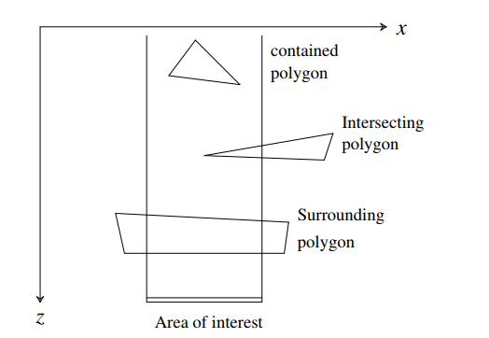
More than one polygon is intersecting ( contained ) or surrounding the area but at least one of them is a surrounding polygon: - If one of the surrounding polygons is in front of all the other polygons (by testing the z-coordinates at the corners of the area) then display the intensity value of the polygon; otherwise, keep subdividing

Slide 21


Slide 22
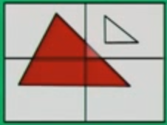

Slide 23
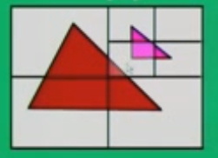

Slide 24
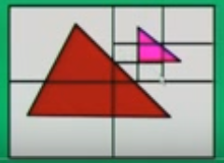

Slide 25
Visible-surface detection algorithms are broadly classified into 2 types : Image space methods Object space methods Image Space methods Visibility is determined point by point pixel by pixel . Accuracy of the calculation is bounded by the display resolution. A change of display resolution requires re-calculation Example Z-Buffer , A-Buffer , Scan Line Method Object-space methods Compare objects and parts of objects to each other to determine which surfaces, as a whole, we should label as visible. Process is unrelated to display resolution or the individual pixel in the image and the result of the process is applicable to different display resolutions. Example Painter Algorithm Area Subdivision

