Slide 1
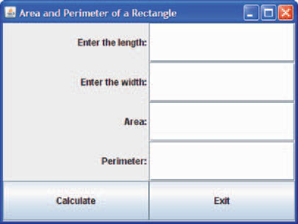
Java GUI
Design Applet based java program to find the area and perimeter of a rectangle given its length and width.

Slide 2
Final Code
import javax.swing.*;
import java.awt.*;
import java.awt.event.*;
import java.awt.Graphics; // program uses class Graphics
import javax.swing.JApplet; // program uses class JApplet
public class RectangleGUIFinal extends JApplet{
private JLabel lengthL, widthL, areaL, perimeterL;
private JTextField lengthTF, widthTF, areaTF,perimeterTF;
private JButton calculateB, exitB;
private ExitButtonHandler ebHandler;
private CalculateButtonHandler cbHandler;
public void init () {
//Create the four labels
lengthL = new JLabel("Enter the length: ", SwingConstants.RIGHT);
widthL = new JLabel("Enter the width: ", SwingConstants.RIGHT);
areaL = new JLabel("Area: ", SwingConstants.RIGHT);
perimeterL = new JLabel("Perimeter: ", SwingConstants.RIGHT);

Slide 3
//Create the four text fields
lengthTF = new JTextField(10);
widthTF = new JTextField(10);
areaTF = new JTextField(10);
perimeterTF = new JTextField(10);
//Create Calculate Button
calculateB = new JButton("Calculate");
cbHandler = new CalculateButtonHandler();
calculateB.addActionListener(cbHandler);
//Create Exit Button
exitB = new JButton("Exit");
ebHandler = new ExitButtonHandler();
exitB.addActionListener(ebHandler);

Slide 4
// Step 2 : Adding content pane to The Container Window
Container pane = getContentPane();
//Step 3: Setting layout inside content pane
pane.setLayout(new GridLayout(5, 2));
//Step 4: Adding Components to the content pane
pane.add(lengthL);
pane.add(lengthTF);
pane.add(widthL);
pane.add(widthTF);
pane.add(areaL);
pane.add(areaTF);
pane.add(perimeterL);
pane.add(perimeterTF);
pane.add(calculateB);
pane.add(exitB);
}

Slide 5
//Step 5 : Adding soul to Components
private class CalculateButtonHandler implements ActionListener{
public void actionPerformed(ActionEvent e){
double width, length, area, perimeter;
length = Double.parseDouble(lengthTF.getText());
width = Double.parseDouble(widthTF.getText());
area = length * width;
perimeter = 2 * (length + width);
areaTF.setText("" + area);
perimeterTF.setText("" + perimeter);
}
}
private class ExitButtonHandler implements ActionListener{
public void actionPerformed(ActionEvent e){
System.exit(0);
}
}
public void paint( Graphics g ){
super.paint( g );
}
}

